Slide 1
What is Metadata and Different tools used in it
Created By :
Yash Bhadania
Jugal Mehta

Slide 2
What is Metadata ?
The Metadata or the Meta content is the data, providing some important information about data which can be used to analyze the evidence, ownership and quality.

Slide 3
Text Documents (e.g., DOCX, PDF, TXT)
Title
Author
Subject
Keywords
Creation Date
Modification Date
Language
Character Encoding
Version
File Size
Page Count
Font Information
Security Settings
Comments and Annotations
Digital Signature

Slide 4
Spreadsheets (e.g., XLSX, CSV)
Title
Author
Creation Date
Modification Date
Sheet Names
Cell Data Types
Formulas
File Size
Data Range

Slide 5
Presentations (e.g., PPTX)
Title
Author
Creation Date
Modification Date
Slide Count
Slide Titles
Template
Embedded Media
File Size
Transition Effects

Slide 6
Tools
ExifTool
Apache Tika
LibreOffice
Zotero
Greenstone
Koha
AccessData FTK (Forensic Toolkit)
EnCase Forensic
Magnet AXIOM
Cellebrite UFED
Belkasoft Evidence Center
Adobe Acrobat Pro

Slide 7
Images (e.g., JPEG, PNG)
Title
Author
Creation Date
Modification Date
File Size
Dimensions
Resolution
Color Depth
Camera Settings
Geolocation

Slide 8
Video Files (e.g., MP4, AVI)
Title
Director
Cast
Duration
Resolution
Frame Rate
File Size
Bitrate
Creation Date
Modification Date

Slide 9
Tools
Autopsy
FotoForensics
JPEGSnoop
Exiftool
Forensically
Amped Authenticate
Ghiro
Adobe Bridge
Forensic Toolkit (FTK)
Belkasoft Evidence Center
OSForensics
Magnet AXIOM

Slide 10
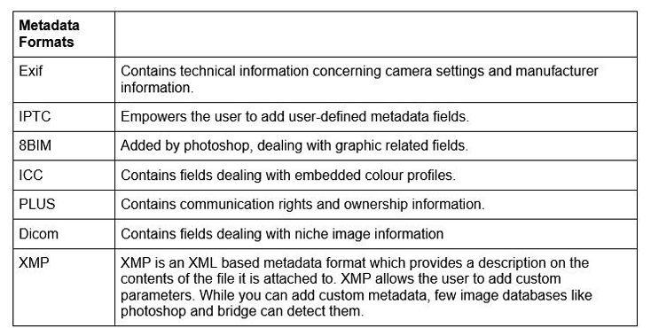

Slide 11
Different Metadata Datasets
https://github.com/common-voice/cv-dataset
https://corp.digitalcorpora.org/corpora/mobile/android_13/ios_15_3_1/
https://forensicstats.org/data/#:~:text=CSAFE%20offers%20access%20to%20open,and%20databases%20as%20a%20guide
https://data.world/datasets/metadata
https://www.kaggle.com/datasets/googleai/dataset-search-metadata-for-datasets/data

